Slide 1
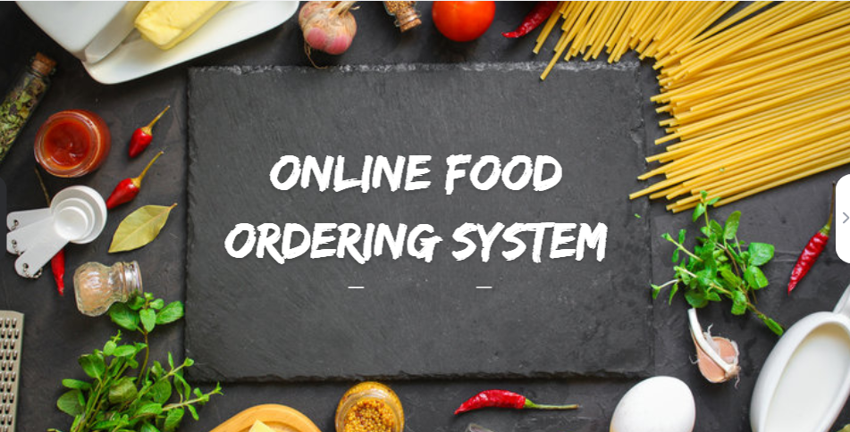

Slide 2
Team 3
Sahil Choudhary
Nisha Gurav
Harshvardhan Padmala
Jitendra Verma
Vikas Singh
Dhana Lakshmi Anke

Slide 3
Work Distribution
Sahil Choudhary - Registration login , hero Page(Backend)
Vikas Singh - Cart , Restaurant(Backend)
Nisha Gurav - Menu, Homepage and payment(Fronend)
Dhana Lakshmi Anke - Login, Cart and Contact us(Frontend)
Harshavardhan Padmala - Homepage,Menu and Customer registration(Frontend)
Jitendra Verma - Restaurant Registration, Homepage(Frontend)

Slide 4
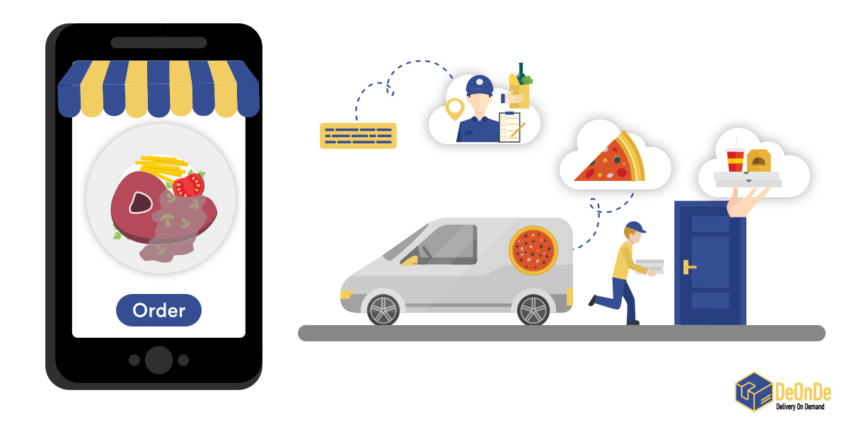
Abstract
The Online Food Ordering System is designed to provide a convenient and efficient platform for users to browse, select, and order food from a variety of restaurants. This system aims to bridge the gap between customers and restaurants by offering an intuitive and user-friendly interface accessible via web and mobile applications. Key features include real-time menu updates, secure payment processing, order tracking, and customer feedback mechanisms. Restaurants benefit from increased visibility and streamlined order management, while customers enjoy a seamless dining experience from ordering to delivery. The system employs modern web technologies and robust backend infrastructure to ensure scalability, reliability, and security.

Slide 5
Introduction
The Online Food Ordering System is a digital platform designed to streamline the process of ordering food from restaurants and food outlets. This system serves as a bridge between customers and food service providers, enabling a more efficient, user-friendly, and accessible dining experience. It allows customers to browse through a digital menu, select their desired dishes, and place orders with just a few clicks. The integration of advanced features such as real-time order tracking, secure payment gateways, and customer feedback mechanisms further enhances the user experience.
For restaurants, the system offers a robust management interface to update menus, manage orders, and analyze customer preferences. This leads to improved service quality and operational efficiency. Additionally, the system’s data analytics capabilities enable food service providers to make informed decisions to grow their business.

Slide 6
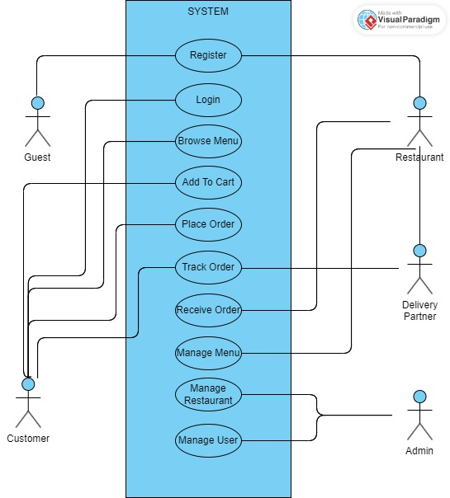
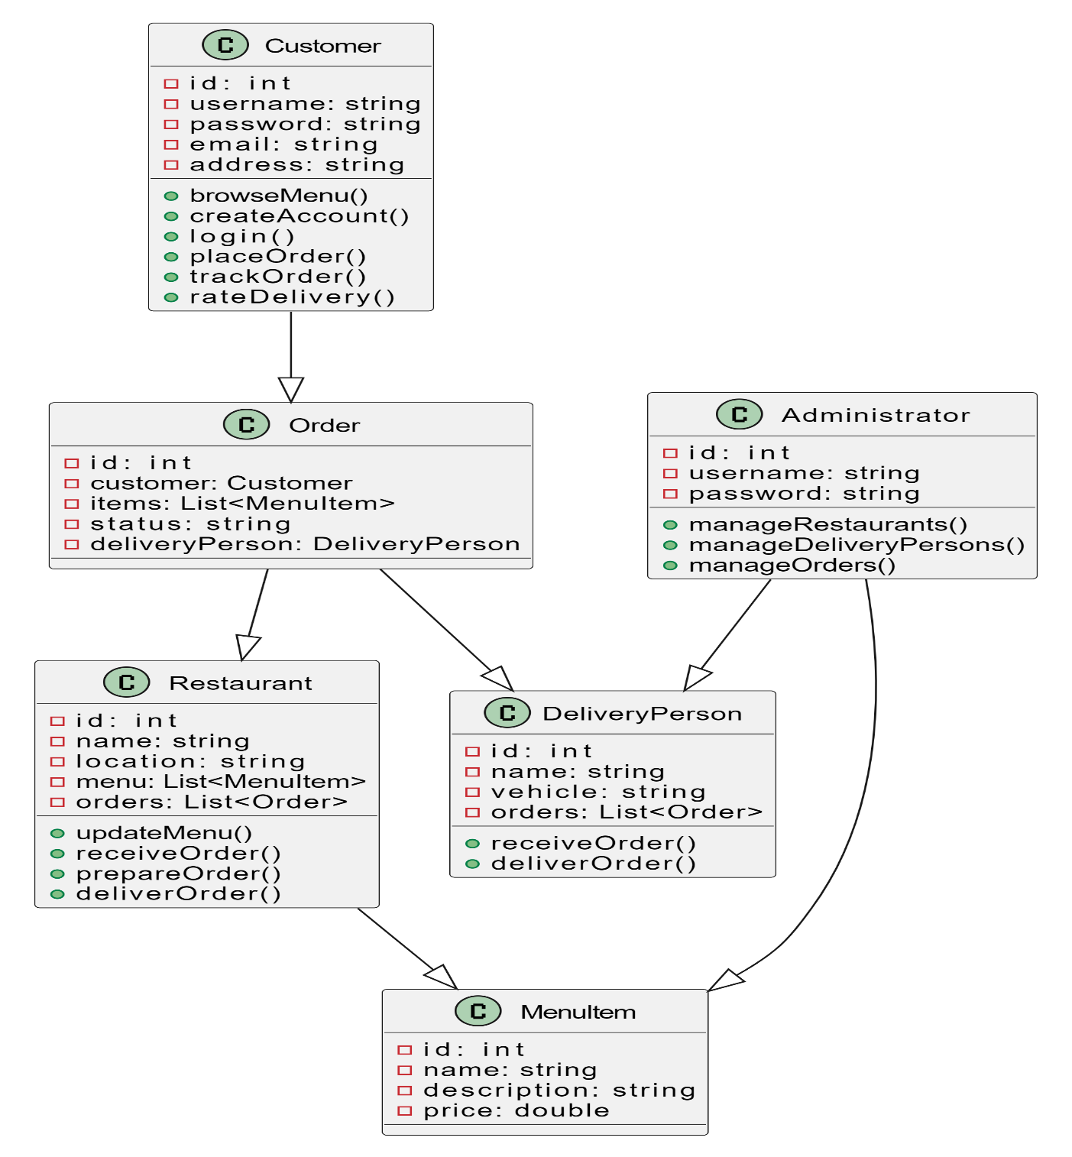
Use case Diagram and Class Diagram

Slide 7

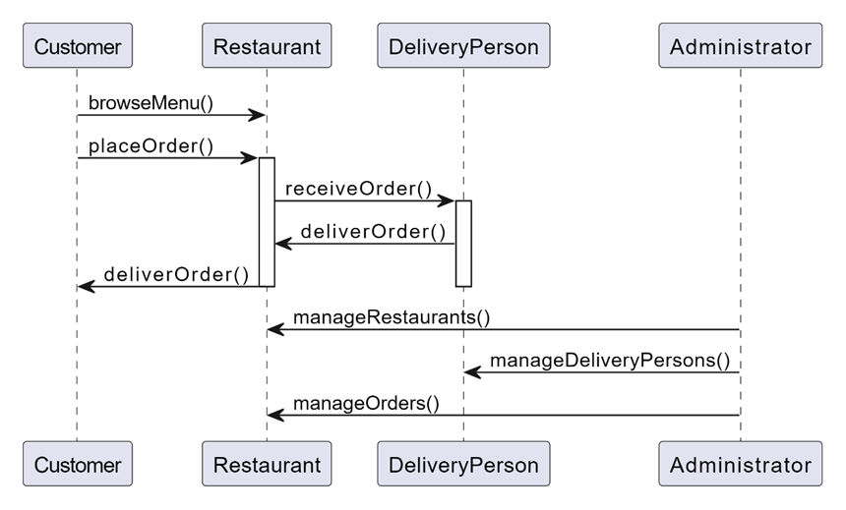
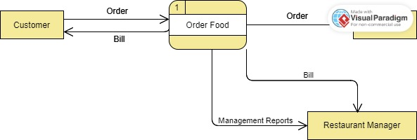
Sequence Diagram and Data Flow Diagram

Slide 8
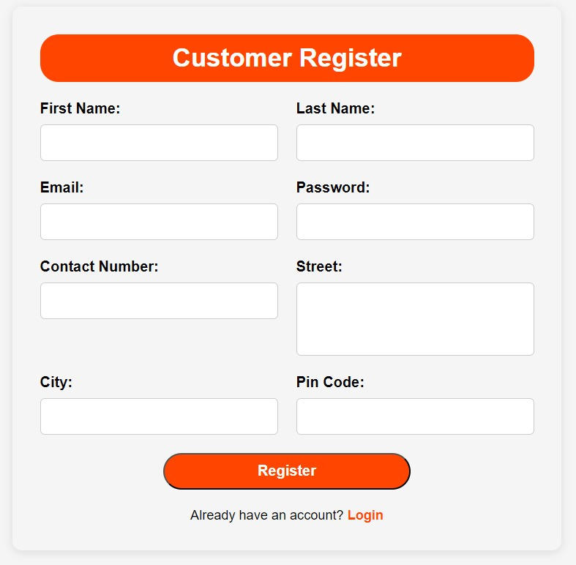
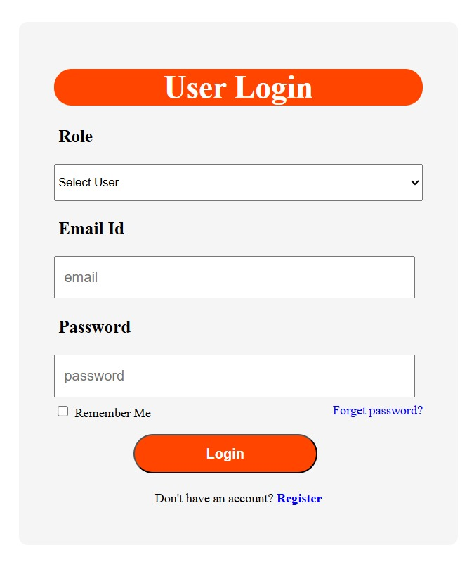
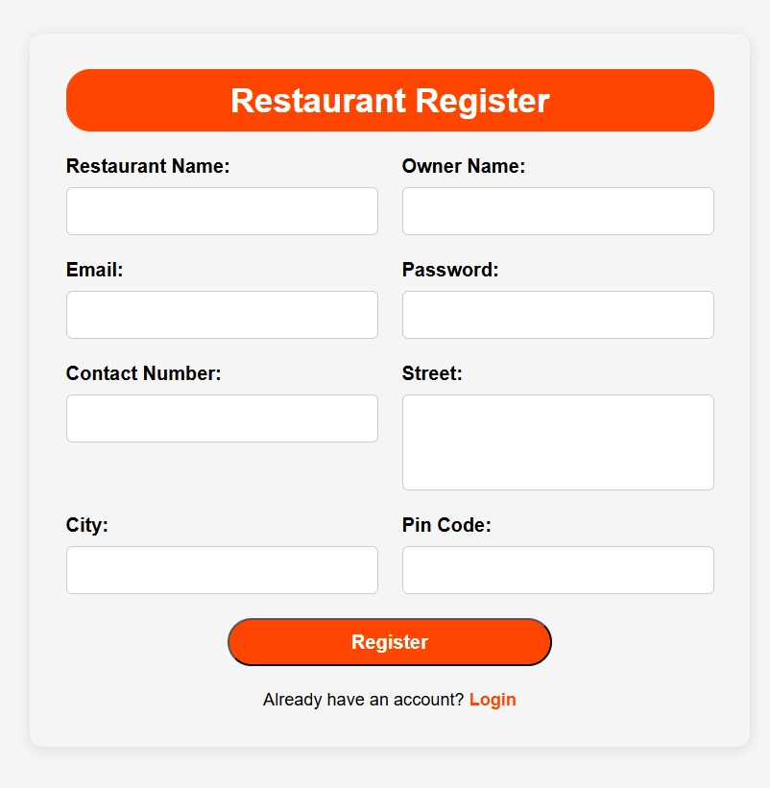
Registration and Login
Implemented registration functionality.
Developed user login mechanism.
Integrated email verification and password reset features

Slide 9
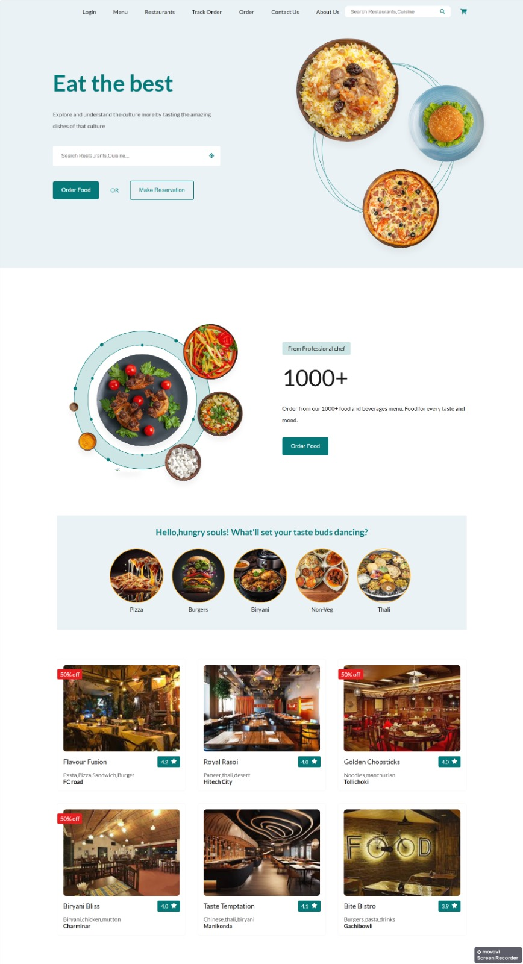
Home Page
It features options to log in, view the menu, search for restaurants or cuisines, track orders, and contact support.
The page highlights food items, popular dishes, and a selection of featured restaurants with ratings and descriptions.

Slide 10
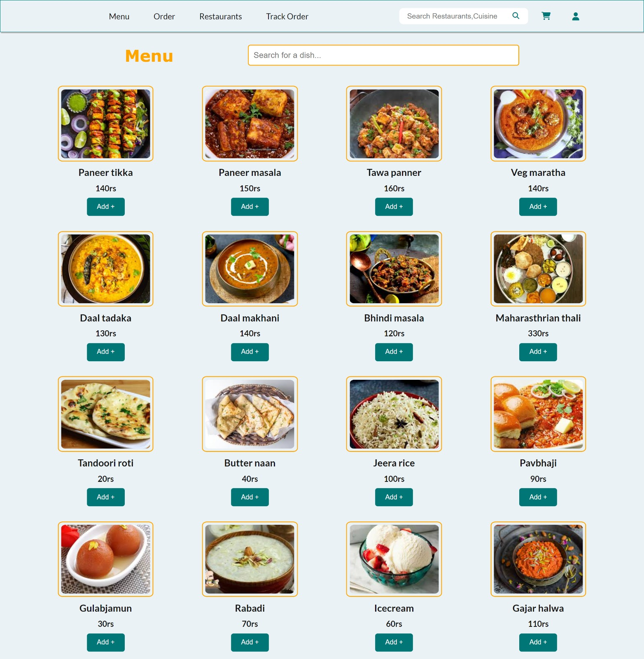
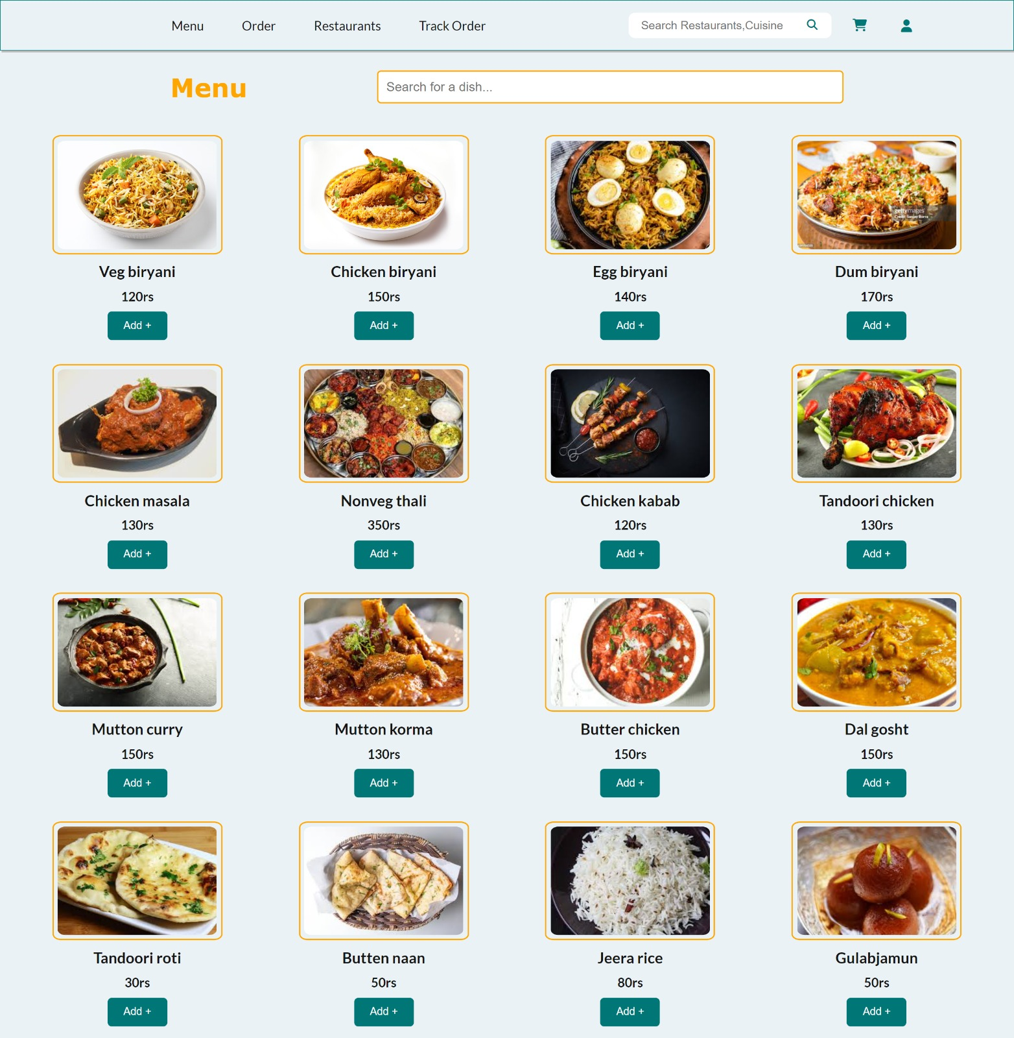
Menu Page
Easy-to-navigate menu pages with clear categories for different types of food.
Detailed descriptions and images of dishes to help users choose what they want to order.

Slide 11
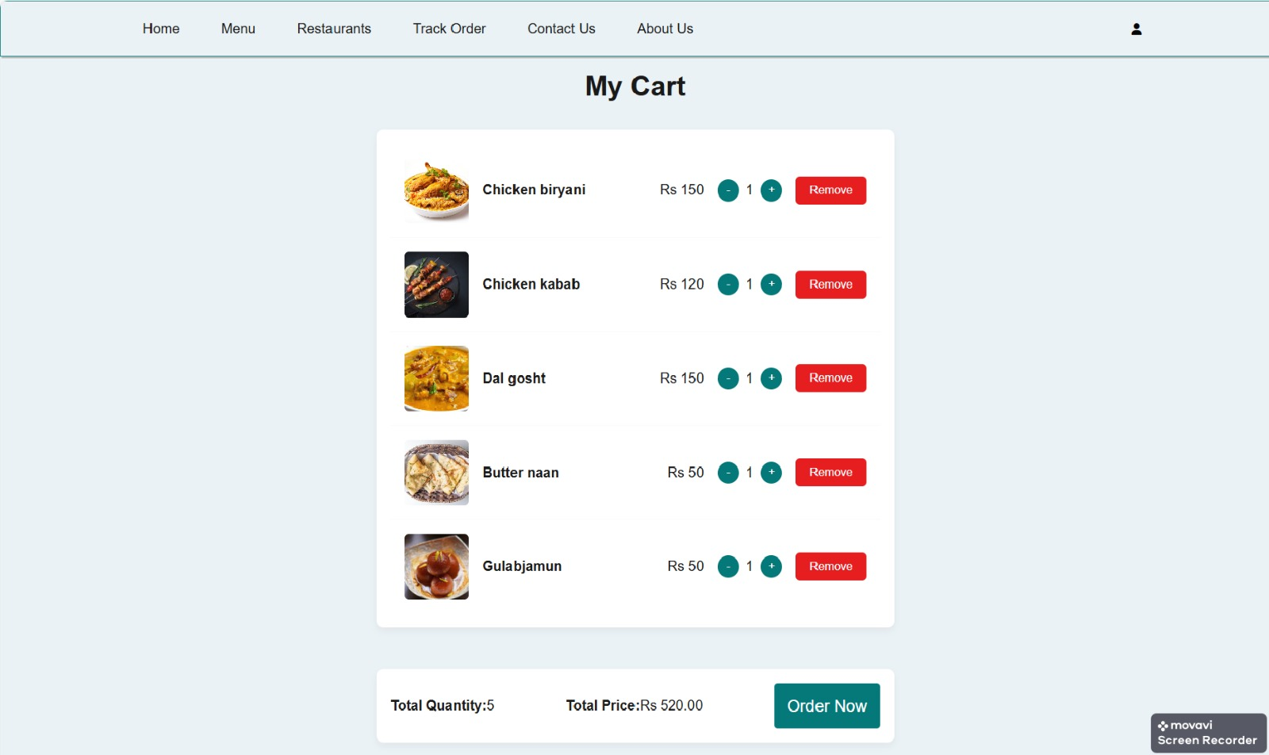
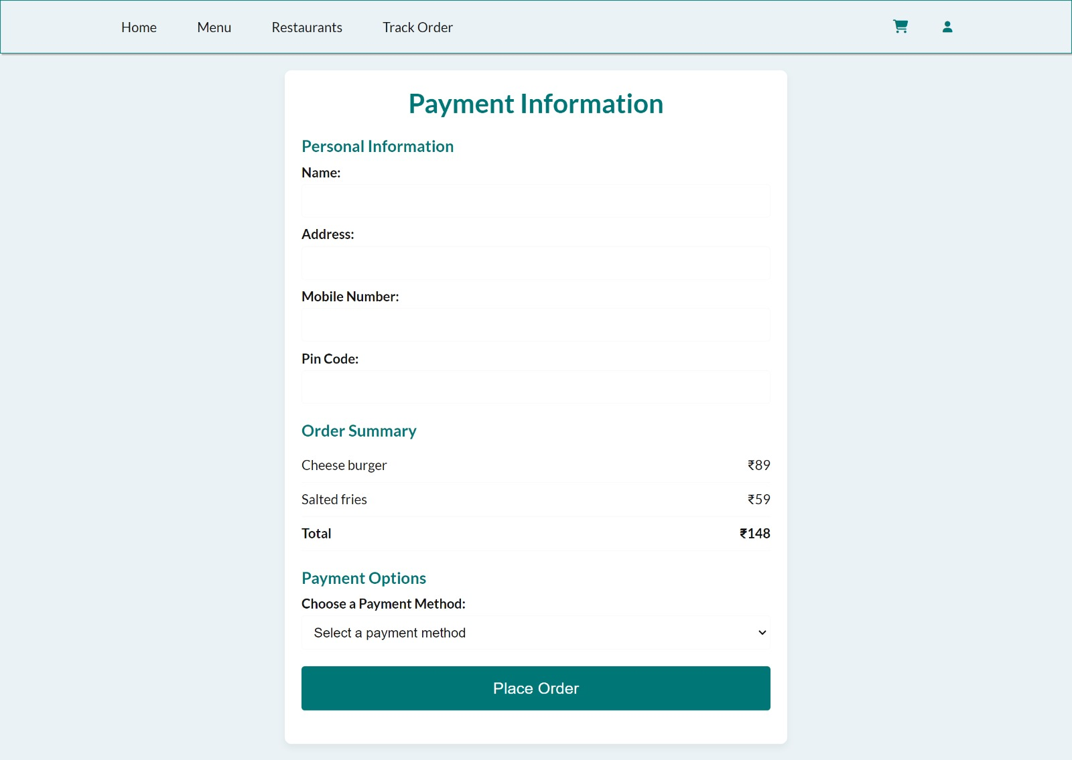
Cart and Payment
Easy to add, remove, or change how much of something you want to buy. When you're ready to buy, it's quick and clear what you're getting and how much it costs before you pay.
Safe and secure payment options, like credit cards or digital wallets, for hassle-free transactions.

Slide 12
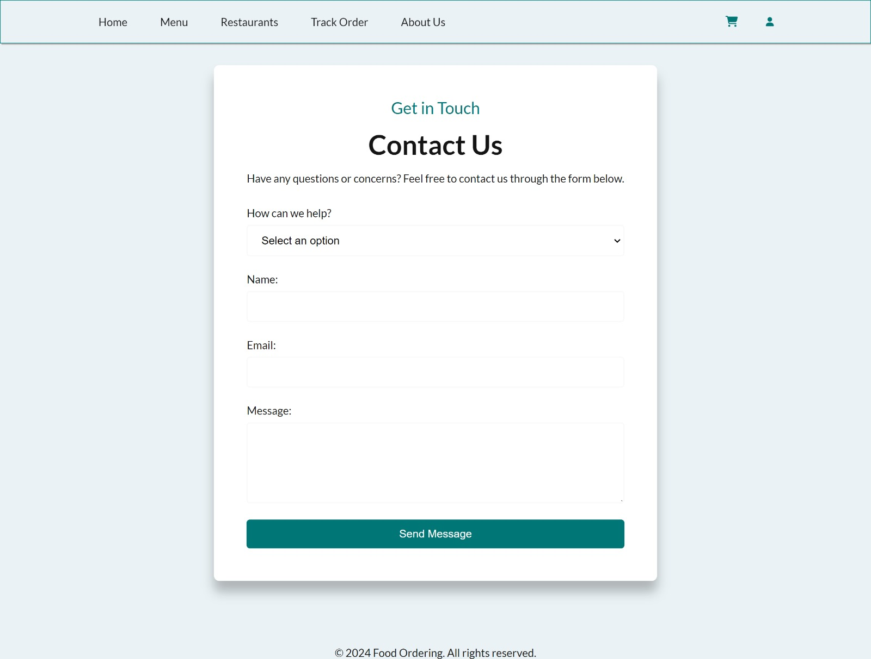
Contact us
To reach out for help or questions, like a contact form or email.
Quick responses and clear communication to address any concerns or inquiries users may have.

Slide 13
Future Scope
Subscription Services
1) Meal Plans: Offer subscription-based meal plans for regular deliveries, such as weekly or monthly meal boxes.
2)Exclusive Offers: Provide exclusive deals and offers to subscribers.
Loyalty Programs and Rewards
1)Point-Based System: Introduce a loyalty program where customers earn points for each order, which can be redeemed for discounts or free items.
2)Referral Bonuses: Implement a referral program where users can earn rewards for referring new customers to the platform.

Slide 14
Conclusion
The development of your online food ordering website is a significant achievement, enhancing customer convenience and restaurant efficiency. To ensure continued growth, focus on integrating AI for personalized recommendations, expanding payment options, exploring new markets, and promoting sustainability initiatives. These steps will help your platform remain competitive and attract a broader audience.

Slide 15
Thank You!

